Slide 1
Performance Comparison & Analysis of Lock-base & Lock-free
Concurrent Skip List
Presented by:
Yixing Wang
Weiyu Zhu

Slide 2
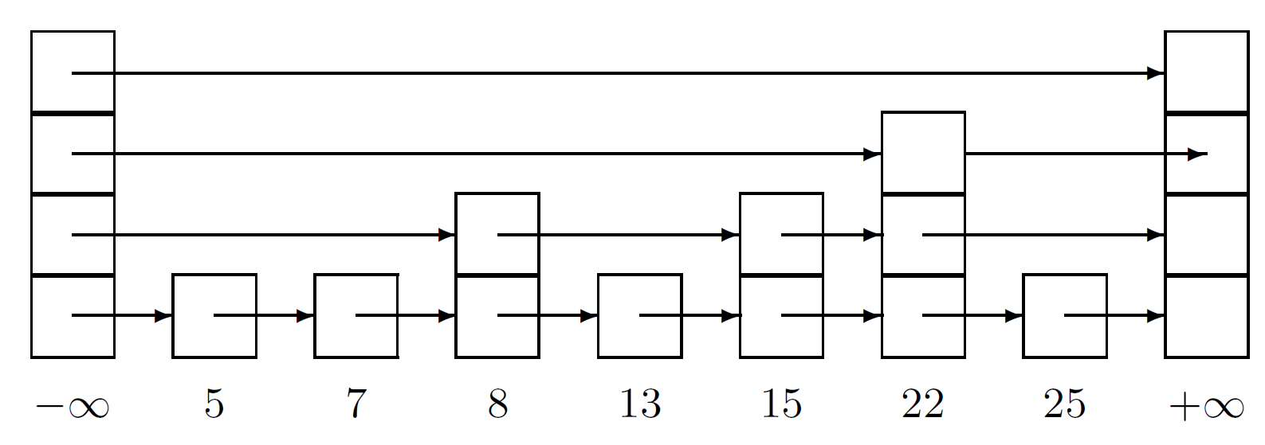
Skip List
Fast Search - Average : O(logn)
Several Layers of linked-list, search from the highest layer, proceeding to next lower layers - effectively SKIP nodes.

Slide 3
Concurrent Skip List
Coarse-Grained Lock Based
Fine-Grained Lock Based
Lock Free

Slide 4
Coarse-Grained
Use locks around add(), remove() and contains() operations to guarantee mutual exclusion.
… public synchronized boolean add(int key) …
Easy to implement, but need more concurrent access

Slide 5
Fine-Grained - Maurice Herlihy, et al
Node {
Int key, topLevel; Node[] next;
Boolean marked; //used to make remove operations
atomic, logically delete
Boolean fullyLinked; //set to true after a node has been linked in at
all its layers
…… }
a key exists in the set if and only if it's unmarked and fully linked.

Slide 6
findNode
Contains
Returns -1, if a key doesn’t exist.
Returns the highest layer the key was found
Record its predecessors and successors in each layer in two arrays(preds[] and succs[]).
Eg. findNode(15), return 1.
preds[] = {13, 8, head, head} succs[] = {15, 15, 22, tail}}
findNode + check its marked and fullyLinked flag

Slide 7
Add Operation:
findNode, check the marked and fullyLinked.
Lock and validate all the predecessors
valid = !pred.marked && !succ.marked && pred.next[level]==succ;
Link new node into list, sets the fullyLinked flag.
Releasing all its locks.

Slide 8
Remove Operation:
findNode, check marked and fullyLinked flag
Lock and Mark the node: logically deletes it.
Lock and validate all the predecessors
valid = !pred.marked pred.next[level]==succ;
Physically delete the node.
Releasing all its locks.

Slide 9
Lock-free
Use AtomicMarkableReference & CAS
contains: similar, but only check marked
Add: CAS to check validity and link to bottom-level
Restart if something changes
Remove: logically delete node by marking it
Restart if already removed or next changes
findNode: search for unmarked node; physically deletes marked nodes

Slide 10
Performance & Analysis
SkipLists:
Coarse-grained
Fine-grained
Lock-free
Standard “ConcurrentSkipListSet”
Parameters:
Number of threads
Number of Operations
Range
Operation Types (percentage of contains, add & remove)

Slide 11
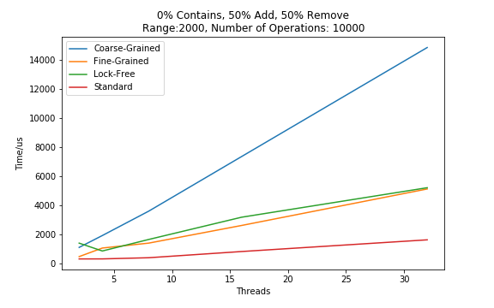
Performance & Analysis
# of threads:
2
4
8
16
32

Slide 12
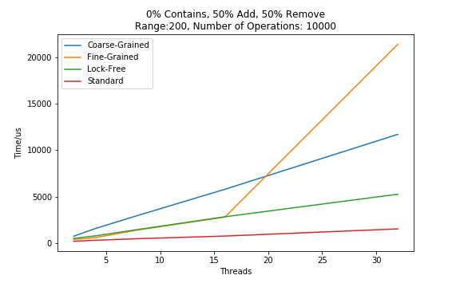
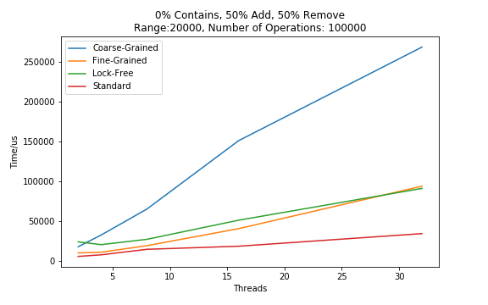
Performance & Analysis
Larger range -> slightly longer run time
Fine-grained & Lock-free have similar performance
More threads -> longer run time
Best: ConcurrentSkipListSet Worst: Coarse-grained

Slide 13
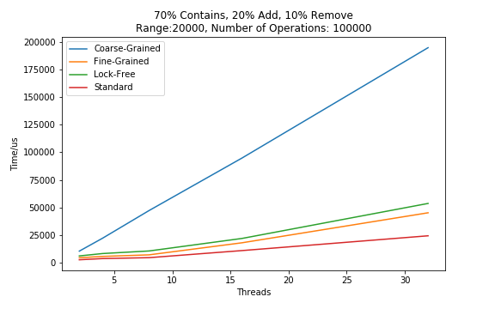
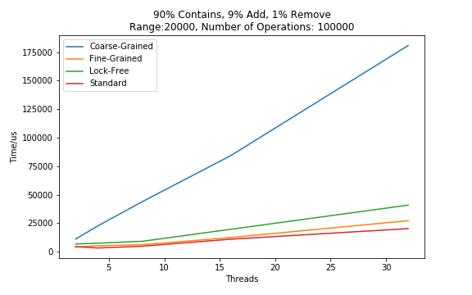
Performance & Analysis
More contains -> shorter run time (contains is wait-free)
More contains -> closer to standard library

Slide 14
Conclusion
Fine-grained and lock-free implementations have similar performance
Better than coarse-grained, worse than standard library
More threads give longer run time
Different operations cost different time: contains wait-free
Possible optimizations exist

Slide 15
References
[1] Pugh, William. "Skip lists: a probabilistic alternative to balanced trees." Communications of the ACM 33.6 (1990): 668-677.
[2] Heller, Steve, et al. "A lazy concurrent list-based set algorithm." International Conference On Principles Of Distributed Systems. Springer, Berlin, Heidelberg, 2005.
[3] Herlihy, Maurice, et al. "A provably correct scalable concurrent skip list." Conference On Principles of Distributed Systems (OPODIS). 2006.
[4] Herlihy, Maurice, and Nir Shavit. The art of multiprocessor programming. Morgan Kaufmann, 2011

